Slide 1
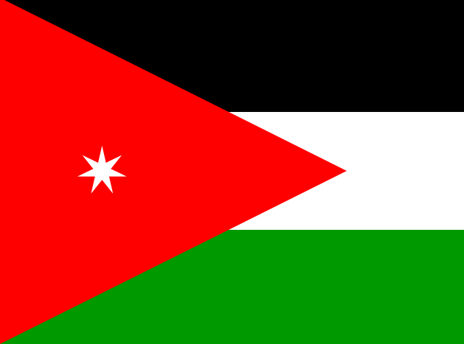
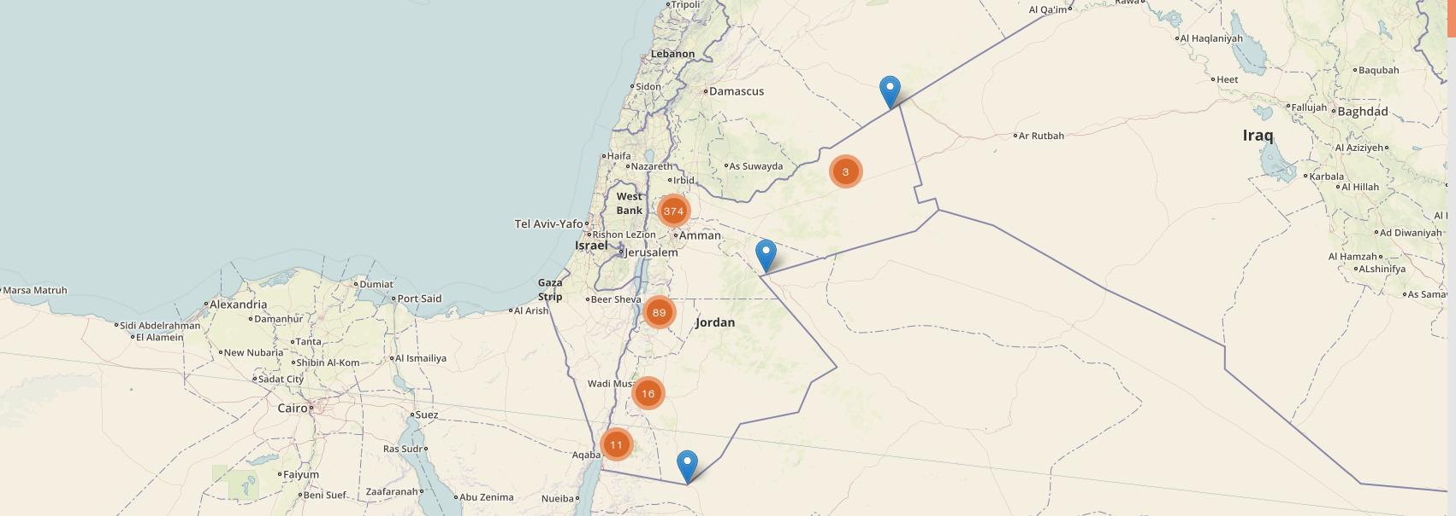
Jordan · Public Health Surveillance
Meerkat Software Training
Frontend Javascript Programming

Slide 2
Overview
Talk: Introducing web programming [15]
Exercises: HTML, CSS and SASS [30]
Talk: Meerkat Frontend – A Python Flask Application [15]
Exercise: Editing Meerkat Frontend [55]
Summary [5]
[Total time: 120 mins]

Slide 3
Introducing the internet

Slide 4
HTTP: Hypertext Transfer Protocol

Slide 5
A typical web page response

Slide 6
The web technology stack

Slide 7
Exercise: HTML, CSS and SASS
Content and Formatting

Slide 8
Meerkat Frontend
A Python Flask Application

Slide 9
Python Flask

Slide 10
The Build Process: Gulp, Bower & NPM

Slide 11
Jinja2 and template rendering

Slide 12
Tips and Tricks

Slide 13
Exercise: Editing Meerkat Frontend
Getting to grips with the code

Slide 14
Summary
A web application uses many different technologies.
Meerkat Frontend requires understanding:
HTTP, Python, Jinja2, HTML, CSS (SASS), Javascript
Meerkat Frontend is built using Gulp, Bower and NPM
Countless tutorials/docs online to help you e.g...
www.w3schools.com
flask.pocoo.org
jinja.pocoo.org
and of course: google.com

